Slide 1
Flooring ORDERS Project
Thomas Lee

Slide 2
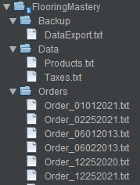
Specification
CRUD application
Each order consists of fields such as customer, productType, state…
Read files for product type and state-tax information
Write files for each order date, the backup file
Allow the user to display, add, remove, edit, backup orders

Slide 3
Design Phase
SDLC - Waterfall and Iterative
Flavour of development – Agile
Concepts from OpenUP approach:
Inception
Elaboration
Construction
Transition

Slide 4
Inception
Scope, objectives?
Functionality?

Slide 5
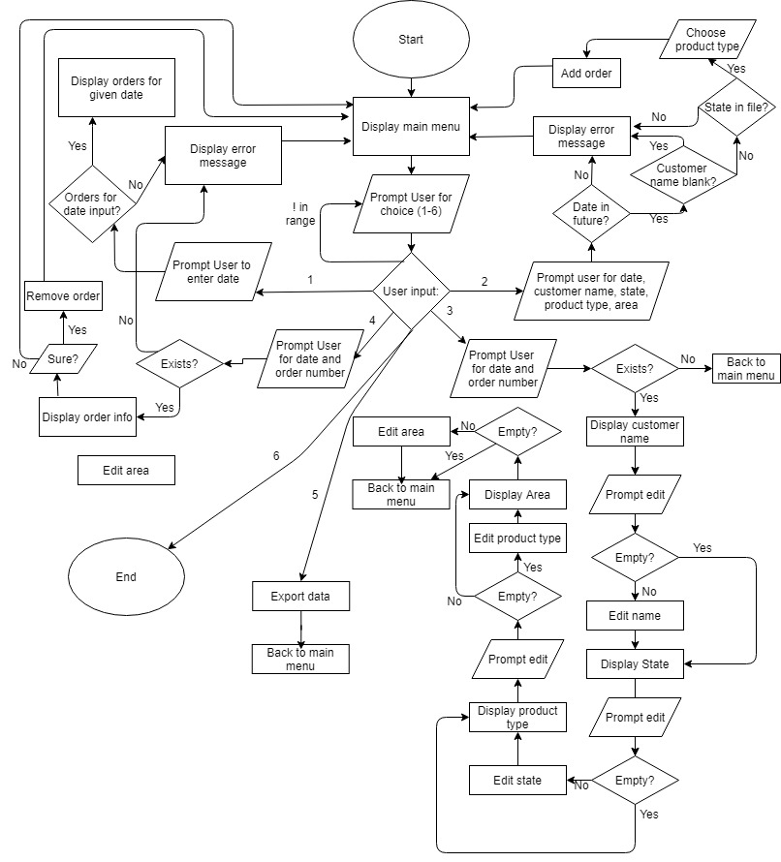

Slide 6
Elaboration
More detailed requirements
MVC design architecture
UI, Data transfer object (Dto), Data access object(Dao), Service Layer, Controller

Slide 7
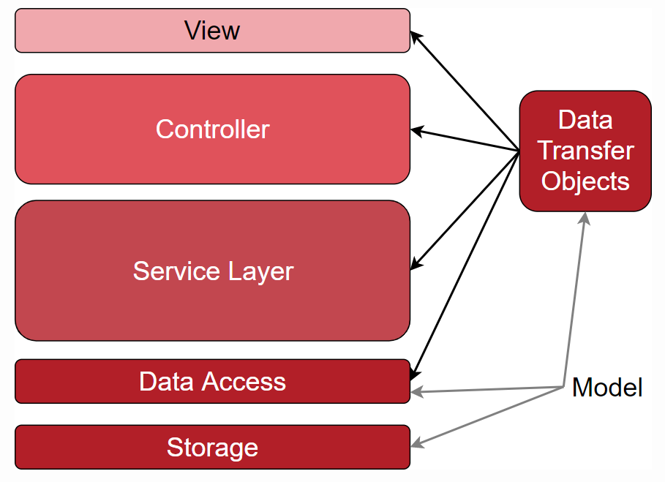
Elaboration
More detailed requirements
MVC design architecture
UI, Data transfer object (Dto), Data access object(Dao), Service Layer, Controller

Slide 8
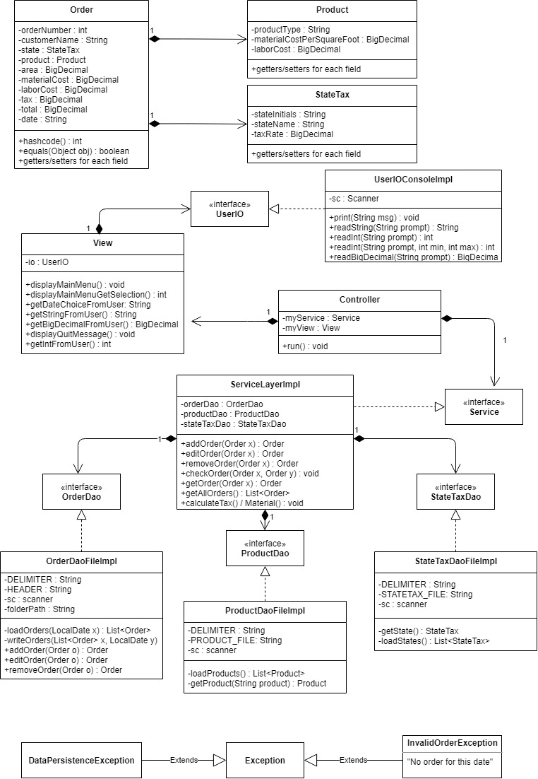

Slide 9
Construction
Features
Researching: Java.io.File, regex, DateTime API

Slide 10
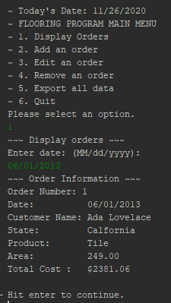
Construction
Display orders from 06/01/2013

Slide 11
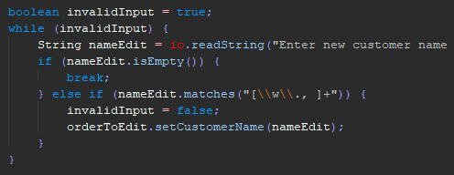
Construction
editOrder()
If the user enters a new name, the name will replace “Ada Lovelace.” If the user hits enter without entering any data, leave as is.
Name should be allowed to contain
[a-z][0-9] as well as periods and comma characters. "Acme, Inc." is a valid name.

Slide 12
Construction
Spring framework for Dependency Injection – XML -Why??
CRUD Application (Persistence storage)

Slide 13
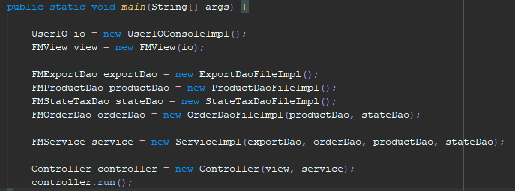
Construction
Spring framework for Dependency Injection – XML
CRUD Application (Persistence storage)

Slide 14
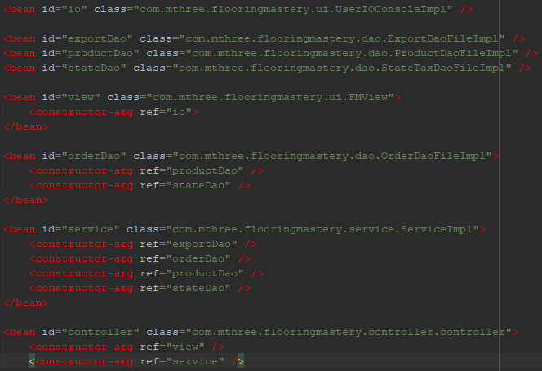
Construction
(External file)

Slide 15
Construction
Spring framework for Dependency Injection – XML
CRUD Application (Persistence storage)

Slide 16

Construction

Slide 17
Construction
Spring framework for Dependency Injection
CRUD Application (Persistence storage)

Slide 18
Construction
Spring framework for Dependency Injection
CRUD Application (Persistence storage)
Testing- JUnit framework
Maven to bring these external libraries in

